Slide 1
Sets & Using AI Tools
TIP102
Week 2
Notes:
🌟 Purpose: Welcome students to the session, set a positive tone, and introduce the focus of the day: sets and using AI tools for learning.
✅ What should I be doing?
Greet students warmly and foster a welcoming environment.
🎙️ What should I be saying?
Welcome to Week 2, Session 2 of TIP102! Today, we’ll be diving into sets—a useful Python data structure—and exploring how AI tools can support your learning.
By the end of today, you’ll understand how to use sets effectively in your coding challenges and how AI tools like ChatGPT or Copilot can assist with debugging and problem-solving.
🙌🏽 How should I engage students?
Ask: "What’s one thing you’re hoping to learn or improve upon today? Drop it in the chat!"
Use enthusiasm: "Who’s excited to explore how AI can make coding challenges a bit less intimidating?"

Slide 2
1 | Welcome 👋🏽 | 0:00 - 0:10
2 | Sets & Using AI Tools | 0:10 - 0:45
3 | BREAK | 0:45 - 0:50
4 | Collaborative Problem Solving | 0:50 - 1:50
5 | Wrap Up | 1:50 - 2:00
Notes:
🌟 Purpose: Provide an overview of the session structure and set clear expectations for timing and activities.
✅ What should I be doing?
Briefly walk students through the agenda.
Highlight key activities, such as the collaborative problem-solving segment, to emphasize participation.
🎙️ What should I be saying?
Here’s our agenda for today. First, we’ll start with an introduction and warm-up to get ready for the session.
Next, we’ll spend about 35 minutes learning about sets and exploring how AI tools can support your learning process.
After a short 5-minute break, we’ll move into collaborative problem solving. This will be a great opportunity to work with your peers on applying today’s concepts.
Finally, we’ll wrap up with reflections and some reminders for the week ahead.
If you have any questions about the agenda or timing, feel free to ask!
🙌🏽 How should I engage students?
Ask: "Does this agenda make sense to everyone? Is there anything specific you’re looking forward to?"
Encourage interaction: "Drop a thumbs-up emoji in the chat if you’re ready to dive in!"
Reassure: "If you’re new to sets or AI tools, don’t worry. We’ll walk through everything step by step together."

Slide 3
Welcome! 👋🏽
10 minutes

Slide 4

Turn on your cameras!
Notes:
🌟 Purpose: Foster visual engagement to create a more interactive and connected virtual environment.
✅ What should I be doing?
Encourage students to turn on their cameras.
🎙️ What should I be saying?
Let’s all turn on our cameras to make this session more interactive and engaging. Seeing everyone’s faces makes it easier to connect and collaborate!
🙌🏽 How should I engage students?
Acknowledge those who turn on their cameras: "Thanks for turning on your camera, [Student Name]! It’s great to see everyone today."

Slide 5

5 minutes
How are you feeling today?
Notes:
https://app.wooclap.com/KEXCKN?from=status-bar

Slide 6
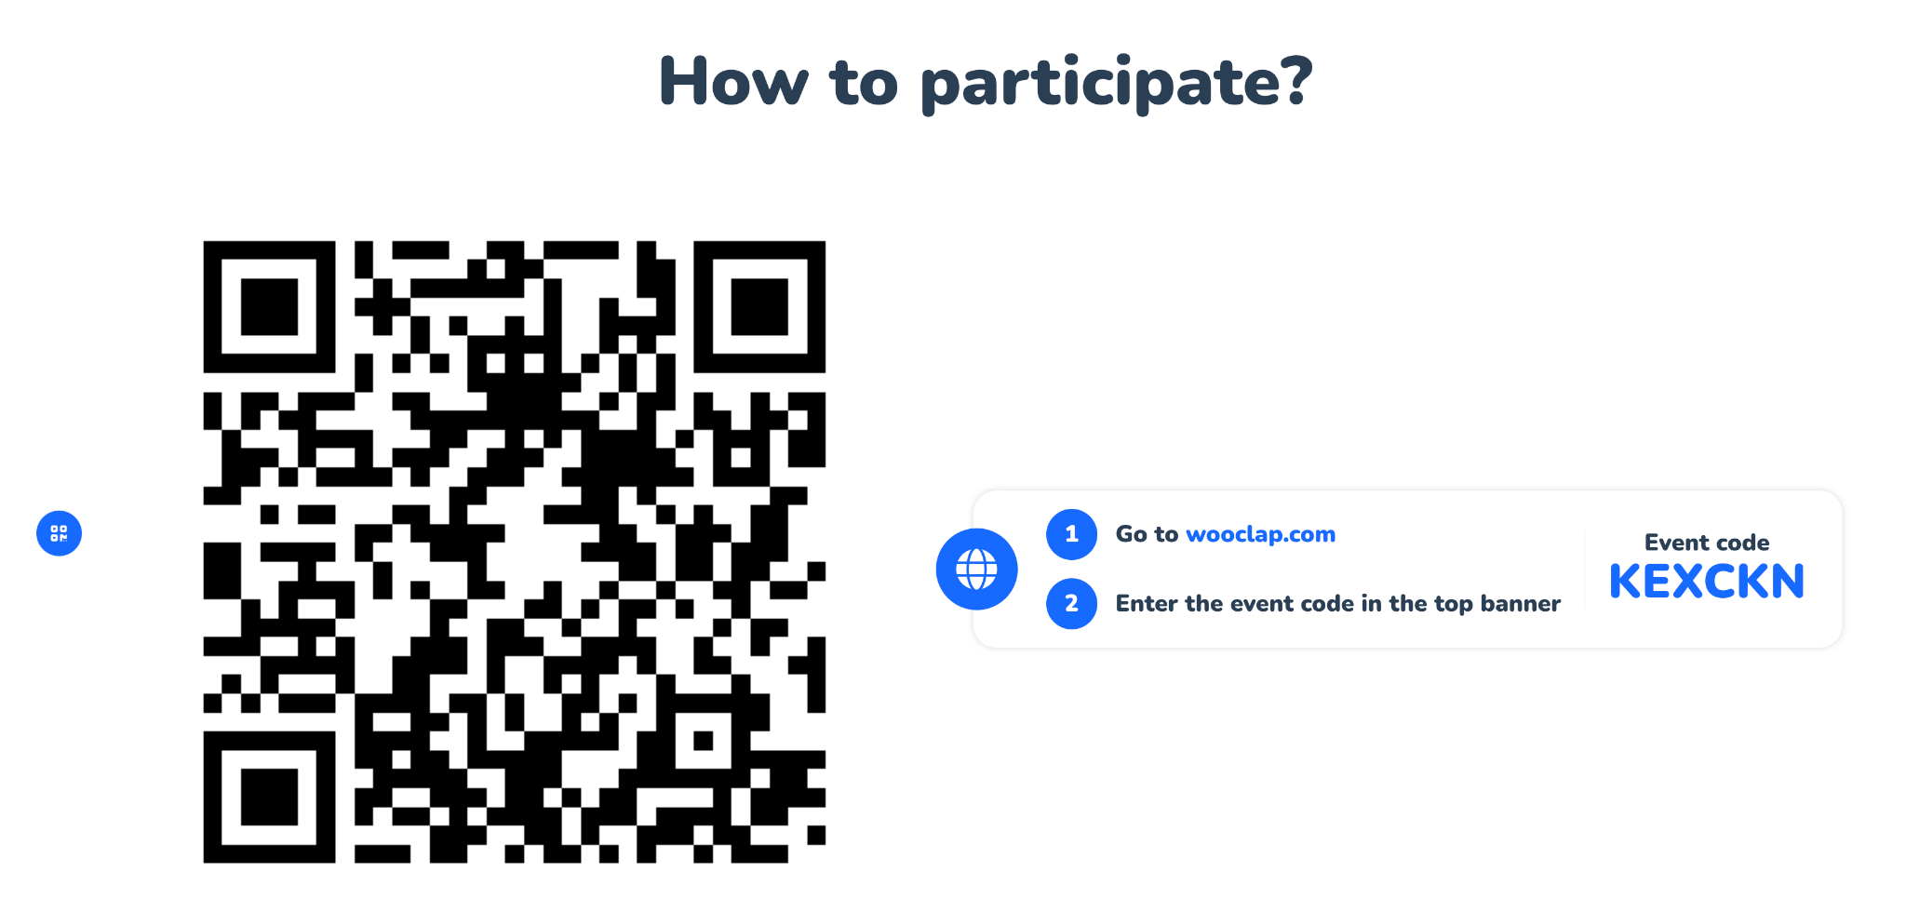
5 minutes
How are you feeling today?
Notes:
https://app.wooclap.com/KEXCKN?from=status-bar

Slide 7

Announcements + Reminders
Please join class with a laptop or PC 💻🖥️ and in a stable environment!
🌲Treehouses Explained!
There will be class on Juneteenth (June 19th)
Note about HackerRank Assessments
✅These are ok to use!:
CodePath-provided materials (lecture recordings, cheatsheets, walkthroughs, demo code, etc.)
Internet documentation (e.g., GeeksforGeeks, MDN, Stack Overflow, official docs)
Google search to clarify syntax, methods, or common approaches
Notes from class or personal study
❌Please do not do the following!:
Copy/paste more than a few words of code directly from outside sources (e.g., full function solutions from Stack Overflow)
Use ChatGPT, Claude, or any other generative AI to write full code solutions
Ask another person for help, explanation, or suggestions
Share their solution or code with others before the due date
Loom Recording of Announcements!

Slide 8

Choosing Your Breakout Room
We’ll share the link to the entry ticket so you can indicate what unit you are on.
We’ll create breakout groups based on the unit you selected.
When it’s Collaborative Problem Solving time, we’ll share the room assignments and demonstrate how to get to your room.
Notes:
🌟 Purpose: Prepare students for collaborative problem-solving time.
✅ What should I be doing?
Explain the breakout room process and answer any logistical questions.
🎙️ What should I be saying?
We’ll use your entry tickets to assign breakout rooms based on your progress in the course. Once assigned, you’ll navigate to your room and start working with your group.

Slide 9
Intro too boring, slow and long
Show how to live share
More depth in lecture + methods that could be used with a dict
Go over harder questions
Live share functionality
Notes:
🌟 Purpose: Share feedback from the previous session and highlight areas of success and improvement.
✅ What should I be doing?
Summarize feedback from the previous session's survey and present key takeaways.
🎙️ What should I be saying?
From your feedback, it seems many of you enjoyed [highlighted aspect]. One suggestion was [area for improvement]. We’ll work on that today.
🙌🏽 How should I engage students?
Ask: "Does anyone have additional feedback or suggestions?"

Slide 10
Sets & Using AI Tools
35 minutes

Slide 11
3 minutes
What do we know about sets?
Notes:
🌟 Purpose: Encourage students to reflect on and share their existing knowledge about sets, creating a foundation for the upcoming content.
✅ What should I be doing?
Facilitate a discussion about sets by prompting students to share their thoughts in the chat.
Capture key ideas shared by students to build on during the lesson.
🎙️ What should I be saying?
Let’s take a moment to discuss what we already know about sets. When you hear the term ‘sets’ in Python or programming, what comes to mind?
Feel free to share any characteristics, use cases, or even questions you have about sets in the chat.
For example, you might know that sets are used to store unique elements, or that they can help remove duplicates from a dataset. Let’s see what else we can come up with as a group!
🙌🏽 How should I engage students?
Encourage participation: "Don’t worry if you’re not sure. Just share what you think, even if it’s a guess!"
Address misconceptions: If a student shares incorrect information, acknowledge their effort and provide clarification. For example:
Student: "Sets keep elements in order."
Response: "Great thought! Sets actually don’t guarantee order. That’s one of the things that makes them different from lists. Thanks for bringing this up—it’s an important distinction!"
Follow-up questions:
"Why do you think sets don’t allow duplicate elements?"
"Have you ever encountered a problem where removing duplicates was helpful? How did you solve it?"
Summarize insights: "Awesome responses! We’ll explore these ideas further as we dive deeper into sets."

Slide 12
Sets
Unordered collections of unique elements.
Use cases: Removing duplicates, performing set operations (e.g., unions and intersections).
s = {1, 2, 3}
Notes:
🌟 Purpose: Introduce students to the concept of sets in Python, emphasizing their properties, use cases, and practical applications.
✅ What should I be doing?
Explain the definition of sets and their unique characteristics.
Highlight the use cases of sets with examples.
Connect the concept to real-world scenarios or problems where sets can be applied.
🎙️ What should I be saying?
Now that we’ve reflected on what we know about sets, let’s formalize our understanding. In Python, sets are unordered collections of unique elements. This means they don’t allow duplicates and don’t maintain the order of items.
One of the main reasons to use sets is when you need to eliminate duplicate values from a dataset. Another common use case is performing mathematical set operations, like unions, intersections, or differences.
Here’s a simple example of a set: s = {1, 2, 3}. Notice the curly braces—this is how sets are defined in Python.
Let’s think about where sets might be useful. Imagine you’re working with a list of user IDs from a website, and you want to ensure each ID is unique. Sets would be perfect for this!
🙌🏽 How should I engage students?
Ask questions to check for understanding:
"Why do you think sets don’t allow duplicates? How could this be helpful?"
"Can anyone think of other situations where removing duplicates might be necessary?"
Address misconceptions:
If a student asks about ordering in sets, clarify: "Sets don’t preserve the order of elements because they are optimized for efficiency in checking membership and removing duplicates."
Prompt real-world connections:
"Have you ever worked with a dataset or list where you encountered duplicates? How did you handle it, and could sets have made it easier?"
Encourage participation:
"Feel free to share any questions or examples in the chat as we go through this concept. Your input might help someone else understand better!"

Slide 13
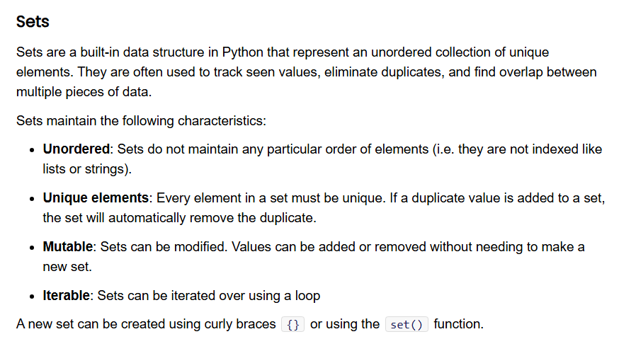
5 minutes
Open the Unit 2 Cheat Sheet and find Sets. Take a moment to review the characteristics, functions, and examples.
What do you notice?
What do you wonder?
Notes:
🌟 Purpose: Encourage students to independently explore the characteristics, functions, and examples of sets using the cheat sheet and to share observations and questions.
✅ What should I be doing?
Direct students to open the Unit 2 Cheat Sheet and locate the section on sets.
Monitor the chat for responses to the prompts: "What do you notice?" and "What do you wonder?"
Provide clarification and expand on any interesting points or common misunderstandings shared by students.
🎙️ What should I be saying?
Now, let’s dive deeper into sets. Please open the Unit 2 Cheat Sheet and find the section on sets. Take a moment to review the characteristics, functions, and examples listed there.
As you’re reviewing, I’d like you to reflect on two questions: What do you notice? What do you wonder? Share your observations and questions in the chat.
For example, you might notice that sets automatically remove duplicates, or you might wonder why sets are unordered. Don’t hesitate to ask any questions—it’s all part of the learning process!
Once we’ve gathered a few responses, we’ll go through them together and clarify any points.
🙌🏽 How should I engage students?
Encourage participation in the chat:
"Feel free to share anything you find surprising or confusing—it’s okay if you don’t fully understand everything yet."
"Who can share an example of when they might use a set based on what they just read?"
Address misconceptions:
If a student is confused about why sets are unordered, explain: "Sets prioritize uniqueness and efficiency for operations like checking membership, which is why ordering is not maintained."
Acknowledge contributions:
Highlight correct or insightful student responses: "Great point! Yes, sets are mutable, which means you can add or remove elements."
Follow-up questions:
"What do you think would happen if you added a duplicate value to a set? Why?"
"How do you think sets compare to other data structures we’ve seen so far, like lists or dictionaries?"
Encourage collaboration:
"If someone else has the same question as you, go ahead and react to their comment—it’s great to see overlapping thoughts!"

Slide 14
Create a set
# Create a new Set
my_set = {1, 2, 3, 4}
Notes:
🌟 Purpose: Introduce students to the concept of sets in Python, emphasizing their properties, use cases, and practical applications.
✅ What should I be doing?
Explain the definition of sets and their unique characteristics.
Highlight the use cases of sets with examples.
Connect the concept to real-world scenarios or problems where sets can be applied.
🎙️ What should I be saying?
Now that we’ve reflected on what we know about sets, let’s formalize our understanding. In Python, sets are unordered collections of unique elements. This means they don’t allow duplicates and don’t maintain the order of items.
One of the main reasons to use sets is when you need to eliminate duplicate values from a dataset. Another common use case is performing mathematical set operations, like unions, intersections, or differences.
Here’s a simple example of a set: s = {1, 2, 3}. Notice the curly braces—this is how sets are defined in Python.
Let’s think about where sets might be useful. Imagine you’re working with a list of user IDs from a website, and you want to ensure each ID is unique. Sets would be perfect for this!
🙌🏽 How should I engage students?
Ask questions to check for understanding:
"Why do you think sets don’t allow duplicates? How could this be helpful?"
"Can anyone think of other situations where removing duplicates might be necessary?"
Address misconceptions:
If a student asks about ordering in sets, clarify: "Sets don’t preserve the order of elements because they are optimized for efficiency in checking membership and removing duplicates."
Prompt real-world connections:
"Have you ever worked with a dataset or list where you encountered duplicates? How did you handle it, and could sets have made it easier?"
Encourage participation:
"Feel free to share any questions or examples in the chat as we go through this concept. Your input might help someone else understand better!"

Slide 15
Create a set - Poll #1
# Create a new Set
my_set = {1, 2, 3, 4}
POLL #1: Why is the following Python expression not a dictionary?
A. It doesn’t use colons to separate keys and values.
B. Dictionaries can’t store integers.
C. The syntax is invalid in Python.
Notes:
🌟 Purpose: Introduce students to the concept of sets in Python, emphasizing their properties, use cases, and practical applications.
✅ What should I be doing?
Explain the definition of sets and their unique characteristics.
Highlight the use cases of sets with examples.
Connect the concept to real-world scenarios or problems where sets can be applied.
🎙️ What should I be saying?
Now that we’ve reflected on what we know about sets, let’s formalize our understanding. In Python, sets are unordered collections of unique elements. This means they don’t allow duplicates and don’t maintain the order of items.
One of the main reasons to use sets is when you need to eliminate duplicate values from a dataset. Another common use case is performing mathematical set operations, like unions, intersections, or differences.
Here’s a simple example of a set: s = {1, 2, 3}. Notice the curly braces—this is how sets are defined in Python.
Let’s think about where sets might be useful. Imagine you’re working with a list of user IDs from a website, and you want to ensure each ID is unique. Sets would be perfect for this!
🙌🏽 How should I engage students?
Ask questions to check for understanding:
"Why do you think sets don’t allow duplicates? How could this be helpful?"
"Can anyone think of other situations where removing duplicates might be necessary?"
Address misconceptions:
If a student asks about ordering in sets, clarify: "Sets don’t preserve the order of elements because they are optimized for efficiency in checking membership and removing duplicates."
Prompt real-world connections:
"Have you ever worked with a dataset or list where you encountered duplicates? How did you handle it, and could sets have made it easier?"
Encourage participation:
"Feel free to share any questions or examples in the chat as we go through this concept. Your input might help someone else understand better!"

Slide 16
Create a set - Poll #1
x = {1, 2, 3} # set
x = {1: 'a', 2: 'b', 3: 'c'} #dictionary
# Create a new Set
my_set = {1, 2, 3, 4}
POLL #1: Why is the following Python expression not a dictionary?
A. It doesn’t use colons to separate keys and values.
B. Dictionaries can’t store integers.
C. The syntax is invalid in Python.
Notes:
🌟 Purpose: Introduce students to the concept of sets in Python, emphasizing their properties, use cases, and practical applications.
✅ What should I be doing?
Explain the definition of sets and their unique characteristics.
Highlight the use cases of sets with examples.
Connect the concept to real-world scenarios or problems where sets can be applied.
🎙️ What should I be saying?
Now that we’ve reflected on what we know about sets, let’s formalize our understanding. In Python, sets are unordered collections of unique elements. This means they don’t allow duplicates and don’t maintain the order of items.
One of the main reasons to use sets is when you need to eliminate duplicate values from a dataset. Another common use case is performing mathematical set operations, like unions, intersections, or differences.
Here’s a simple example of a set: s = {1, 2, 3}. Notice the curly braces—this is how sets are defined in Python.
Let’s think about where sets might be useful. Imagine you’re working with a list of user IDs from a website, and you want to ensure each ID is unique. Sets would be perfect for this!
🙌🏽 How should I engage students?
Ask questions to check for understanding:
"Why do you think sets don’t allow duplicates? How could this be helpful?"
"Can anyone think of other situations where removing duplicates might be necessary?"
Address misconceptions:
If a student asks about ordering in sets, clarify: "Sets don’t preserve the order of elements because they are optimized for efficiency in checking membership and removing duplicates."
Prompt real-world connections:
"Have you ever worked with a dataset or list where you encountered duplicates? How did you handle it, and could sets have made it easier?"
Encourage participation:
"Feel free to share any questions or examples in the chat as we go through this concept. Your input might help someone else understand better!"

Slide 17
Create a set
# Create a new Set
my_set = {1, 2, 3, 4}
# Using the set() function
another_set = set([1, 2, 3, 4])
Notes:
🌟 Purpose: Introduce students to the concept of sets in Python, emphasizing their properties, use cases, and practical applications.
✅ What should I be doing?
Explain the definition of sets and their unique characteristics.
Highlight the use cases of sets with examples.
Connect the concept to real-world scenarios or problems where sets can be applied.
🎙️ What should I be saying?
Now that we’ve reflected on what we know about sets, let’s formalize our understanding. In Python, sets are unordered collections of unique elements. This means they don’t allow duplicates and don’t maintain the order of items.
One of the main reasons to use sets is when you need to eliminate duplicate values from a dataset. Another common use case is performing mathematical set operations, like unions, intersections, or differences.
Here’s a simple example of a set: s = {1, 2, 3}. Notice the curly braces—this is how sets are defined in Python.
Let’s think about where sets might be useful. Imagine you’re working with a list of user IDs from a website, and you want to ensure each ID is unique. Sets would be perfect for this!
🙌🏽 How should I engage students?
Ask questions to check for understanding:
"Why do you think sets don’t allow duplicates? How could this be helpful?"
"Can anyone think of other situations where removing duplicates might be necessary?"
Address misconceptions:
If a student asks about ordering in sets, clarify: "Sets don’t preserve the order of elements because they are optimized for efficiency in checking membership and removing duplicates."
Prompt real-world connections:
"Have you ever worked with a dataset or list where you encountered duplicates? How did you handle it, and could sets have made it easier?"
Encourage participation:
"Feel free to share any questions or examples in the chat as we go through this concept. Your input might help someone else understand better!"

Slide 18
Create a set
# Create a new Set
my_set = {1, 2, 3, 4}
# Using the set() function
another_set = set([1, 2, 3, 4])
# Creating an empty set
empty_set = set() # Note: {} creates an empty dictionary, not a set
Notes:
🌟 Purpose: Introduce students to the concept of sets in Python, emphasizing their properties, use cases, and practical applications.
✅ What should I be doing?
Explain the definition of sets and their unique characteristics.
Highlight the use cases of sets with examples.
Connect the concept to real-world scenarios or problems where sets can be applied.
🎙️ What should I be saying?
Now that we’ve reflected on what we know about sets, let’s formalize our understanding. In Python, sets are unordered collections of unique elements. This means they don’t allow duplicates and don’t maintain the order of items.
One of the main reasons to use sets is when you need to eliminate duplicate values from a dataset. Another common use case is performing mathematical set operations, like unions, intersections, or differences.
Here’s a simple example of a set: s = {1, 2, 3}. Notice the curly braces—this is how sets are defined in Python.
Let’s think about where sets might be useful. Imagine you’re working with a list of user IDs from a website, and you want to ensure each ID is unique. Sets would be perfect for this!
🙌🏽 How should I engage students?
Ask questions to check for understanding:
"Why do you think sets don’t allow duplicates? How could this be helpful?"
"Can anyone think of other situations where removing duplicates might be necessary?"
Address misconceptions:
If a student asks about ordering in sets, clarify: "Sets don’t preserve the order of elements because they are optimized for efficiency in checking membership and removing duplicates."
Prompt real-world connections:
"Have you ever worked with a dataset or list where you encountered duplicates? How did you handle it, and could sets have made it easier?"
Encourage participation:
"Feel free to share any questions or examples in the chat as we go through this concept. Your input might help someone else understand better!"

Slide 19
Operating on a Set (not exhaustive)
add(): Adds an element to the set.
my_set.add(4)
remove(): Removes an element from the set. Raises a KeyError if the element is not found.
my_set.remove(2)
discard(): Removes an element if it is present, without raising an error if it is not found.
my_set.discard(2)
clear(): Removes all elements from the set.
my_set.clear()
Notes:
🌟 Purpose: Introduce students to the concept of sets in Python, emphasizing their properties, use cases, and practical applications.
✅ What should I be doing?
Explain the definition of sets and their unique characteristics.
Highlight the use cases of sets with examples.
Connect the concept to real-world scenarios or problems where sets can be applied.
🎙️ What should I be saying?
Now that we’ve reflected on what we know about sets, let’s formalize our understanding. In Python, sets are unordered collections of unique elements. This means they don’t allow duplicates and don’t maintain the order of items.
One of the main reasons to use sets is when you need to eliminate duplicate values from a dataset. Another common use case is performing mathematical set operations, like unions, intersections, or differences.
Here’s a simple example of a set: s = {1, 2, 3}. Notice the curly braces—this is how sets are defined in Python.
Let’s think about where sets might be useful. Imagine you’re working with a list of user IDs from a website, and you want to ensure each ID is unique. Sets would be perfect for this!
🙌🏽 How should I engage students?
Ask questions to check for understanding:
"Why do you think sets don’t allow duplicates? How could this be helpful?"
"Can anyone think of other situations where removing duplicates might be necessary?"
Address misconceptions:
If a student asks about ordering in sets, clarify: "Sets don’t preserve the order of elements because they are optimized for efficiency in checking membership and removing duplicates."
Prompt real-world connections:
"Have you ever worked with a dataset or list where you encountered duplicates? How did you handle it, and could sets have made it easier?"
Encourage participation:
"Feel free to share any questions or examples in the chat as we go through this concept. Your input might help someone else understand better!"

Slide 20
Mathematical Operations on a Set
set1 = {1, 2, 3} set2 = {3, 4, 5}
# Union: Elements in either set
union_set = set1 | set2 # {1, 2, 3, 4, 5}
# Intersection: Elements common to both sets
intersection_set = set1 & set2 # {3}
# Difference: Elements in set1 but not in set2
difference_set = set1 - set2 # {1, 2}
# Symmetric Difference: Elements in either set, but not both
symmetric_difference_set = set1 ^ set2 # {1, 2, 4, 5}
Notes:
🌟 Purpose: Introduce students to the concept of sets in Python, emphasizing their properties, use cases, and practical applications.
✅ What should I be doing?
Explain the definition of sets and their unique characteristics.
Highlight the use cases of sets with examples.
Connect the concept to real-world scenarios or problems where sets can be applied.
🎙️ What should I be saying?
Now that we’ve reflected on what we know about sets, let’s formalize our understanding. In Python, sets are unordered collections of unique elements. This means they don’t allow duplicates and don’t maintain the order of items.
One of the main reasons to use sets is when you need to eliminate duplicate values from a dataset. Another common use case is performing mathematical set operations, like unions, intersections, or differences.
Here’s a simple example of a set: s = {1, 2, 3}. Notice the curly braces—this is how sets are defined in Python.
Let’s think about where sets might be useful. Imagine you’re working with a list of user IDs from a website, and you want to ensure each ID is unique. Sets would be perfect for this!
🙌🏽 How should I engage students?
Ask questions to check for understanding:
"Why do you think sets don’t allow duplicates? How could this be helpful?"
"Can anyone think of other situations where removing duplicates might be necessary?"
Address misconceptions:
If a student asks about ordering in sets, clarify: "Sets don’t preserve the order of elements because they are optimized for efficiency in checking membership and removing duplicates."
Prompt real-world connections:
"Have you ever worked with a dataset or list where you encountered duplicates? How did you handle it, and could sets have made it easier?"
Encourage participation:
"Feel free to share any questions or examples in the chat as we go through this concept. Your input might help someone else understand better!"

Slide 21
5 minutes
When is it best to use a list?
What about a dictionary?
How about a set?
What are some things in common and differences between each of these?
Notes:
Dictionary key and sets are unique
List is like a dictionary with keys as int
🌟 Purpose: Help students compare and contrast lists, dictionaries, and sets, clarifying their unique use cases to solidify understanding of when to use each data structure.
✅ What should I be doing?
Pose each question to the class one at a time: "When is it best to use a list?", "What about a dictionary?", "How about a set?"
Guide the discussion by encouraging students to share their answers in the chat or unmute to respond.
Address any misconceptions and validate correct responses with explanations.
Summarize key points after each question.
🎙️ What should I be saying?
Let’s take a moment to reflect on what we’ve learned so far. I want you to think about three questions. First, when is it best to use a list?
(After responses) Great! Lists are best when you need an ordered collection where duplicates are allowed and indexing is important. For example, keeping track of a series of events or names in a specific order.
Now, let’s move to dictionaries. When do you think they’re most useful?
(After responses) Exactly! Dictionaries are ideal when you need to associate keys with values, like storing student IDs and their corresponding names.
Finally, when is it best to use a set?
(After responses) That’s right! Sets are perfect when you need a collection of unique elements and don’t care about the order. They’re also great for performing operations like unions or intersections.
If you’re unsure, think about the key features: lists allow duplicates and maintain order, dictionaries are about key-value pairs, and sets prioritize uniqueness and efficient lookups.
🙌🏽 How should I engage students?
Encourage active participation:
Ask students to type their responses in the chat or use the "raise hand" feature to share their thoughts.
Example prompt: "Can anyone give me a real-world example of when you might use a dictionary instead of a list or set?"
Address misconceptions:
If a student suggests using a set for maintaining order, clarify: "That’s a common misconception. Sets don’t maintain order, so if you need order, you’d use a list instead."
Use follow-up questions to deepen understanding:
"Why wouldn’t you use a dictionary to store duplicate values?"
"What happens if you add a duplicate to a set?"
Acknowledge correct answers:
"Great example! A dictionary really shines when you need fast lookups for specific keys, like phone numbers associated with names."
"Exactly, a set would automatically remove duplicates if they were added."

Slide 22
Understand When to Use Each
Lists are great for ordered data and iteration
Dictionaries for key-value mapping
Sets for ensuring uniqueness and fast membership checks
Notes:
🌟 Purpose: Clarify the distinct use cases for lists, dictionaries, and sets, enabling students to confidently select the right data structure for specific problems.
✅ What should I be doing?
Review each bullet point, emphasizing key characteristics and practical use cases.
Provide examples for each data structure to solidify understanding.
Encourage students to ask questions or share additional examples.
🎙️ What should I be saying?
Now that we've compared lists, dictionaries, and sets, let's summarize when to use each of them. Starting with lists: they are ideal for ordered data and when you need to iterate through elements in a specific order. For example, if you're storing a list of tasks to complete in sequence, a list is perfect.
Next, dictionaries are best suited for key-value mapping. They shine when you need to look up values quickly using a specific key, like storing student grades where the keys are student IDs and the values are their grades.
Finally, sets are excellent for ensuring uniqueness and performing fast membership checks. For instance, if you're processing a dataset and want to remove duplicates, a set will do that automatically.
Remember, each data structure has its strengths and is optimized for specific scenarios. If you ever feel unsure, think about the problem requirements: Is order important? Are duplicates allowed? Do you need fast lookups?
🙌🏽 How should I engage students?
Ask for real-world examples:
"Can someone share an example of when they might use a list in a project or coding challenge?"
"What’s a scenario where a dictionary would be more efficient than a list?"
"Can you think of a situation where using a set would be the best choice?"
Pose follow-up questions to deepen understanding:
"Why wouldn’t you use a dictionary instead of a set for ensuring uniqueness?"
"How does the absence of order in sets affect their use in certain scenarios?"
Encourage discussion in the chat:
Prompt students to type their responses or questions about the three data structures.
Example: "Type a quick example of a use case for a set in the chat. Let’s see how creative we can get!"

Slide 23

Traffic Lights
GREEN — Keep going! YELLOW — Proceed Slowly RED — Stop!

Slide 24
Poll #2
Given an array of integers nums and an integer target, return indices of the two numbers such that they add up to target.
Which data structure helps you achieve O(n) time complexity?
A. Dictionary
B. List
C. Set

Slide 25
Poll #2
Given an array of integers nums and an integer target, return indices of the two numbers such that they add up to target.
Which data structure helps you achieve O(n) time complexity?
A. Dictionary
B. List
C. Set

Slide 26
Poll #2
Given an array of integers nums and an integer target, return indices of the two numbers such that they add up to target.
Why use a Dictionary and not a set?
A set can only track if a number exists — not where it is.
You’d have the value, but not its index, which is required in the return.

Slide 27
Poll #3
Given an integer array nums, return true if any value appears at least twice.
Return false if every element is distinct.
Which data structure helps detect duplicates in linear time?
A. Dictionary
B. List
C. Set

Slide 28
Poll #3
Given an integer array nums, return true if any value appears at least twice.
Return false if every element is distinct.
Which data structure helps detect duplicates in linear time?
A. Dictionary
B. List
C. Set

Slide 29
Poll #3
Given an integer array nums, return true if any value appears at least twice.
Return false if every element is distinct.
Answer yes/no question “is there a duplicate?”
Don’t care how many times it appears
=> checking existence, not count
Set is simpler and uses less space
Notes:
Obviously can still solve with a dictionary in an interview, not necessarily going to be docked from that
But if asked for improvements this could be a good response

Slide 30
Poll #4
Given an integer num, convert it to a Roman numeral (e.g. XVII).
Which data structure helps find the Roman numeral in O(1) time?
A. Dictionary
B. List
C. Set

Slide 31
Poll #4
Given an integer num, convert it to a Roman numeral.
Which data structure helps find the Roman numeral in O(1) time?
A. Dictionary
B. List
C. Set

Slide 32
Poll #4
Given an integer num, convert it to a Roman numeral.
Which data structure helps find the Roman numeral in O(1) time?
A. Dictionary
B. List
C. Set
val = [1000, 900, 500, 400, 100, 90, 50, 40, 10, 9, 5, 4, 1]
rom = ["M", "CM", "D", "CD", "C", "XC", "L", "XL", "X", "IX", "V", "IV", "I"]

Slide 33



Analogies
List - Books on a bookshelf
Dictionary - A Social Security Number (SSN) Database
Set - A bag of unique marbles

Slide 34
3 minutes
In the chat . . .
Have you ever used an AI tool like ChatGPT or Copilot for learning? How did it help you?
How can we use AI to further improve our understanding of lists, dictionaries and sets?
Notes:
🌟 Purpose: Encourage students to share their experiences with AI tools for learning, fostering engagement and building awareness of AI’s practical applications in education.
✅ What should I be doing?
Facilitate the discussion by prompting students to respond in the chat.
Monitor the chat for responses, calling attention to interesting examples or trends.
Keep the discussion focused and inclusive, ensuring all students feel encouraged to contribute.
🎙️ What should I be saying?
Let’s take a moment to talk about AI tools and how they can support learning. Have you ever used an AI tool like ChatGPT or Copilot for your studies or projects? If yes, how did it help you?
For example, did it help you understand a concept better, debug a piece of code, or brainstorm ideas for a project? Share your experience in the chat.
If you haven’t used these tools, that’s okay! You can let us know if you’ve been curious about them or if you have questions about how they might be helpful.
🙌🏽 How should I engage students?
Encourage responses:
"Type your answers in the chat. You can share as much or as little detail as you’d like!"
Highlight responses:
"That’s a great example! Using ChatGPT for debugging is definitely a popular use case."
"I see a few of you mentioned using Copilot to autocomplete code – that’s a huge time-saver."
Address misconceptions:
If someone shares a negative experience: "That’s a good point. Sometimes AI tools can provide incorrect suggestions. How do you think we can address that?"
If a student is unsure about using AI: "That’s valid. It can feel intimidating at first, but tools like ChatGPT are great assistants when used thoughtfully."

Slide 35
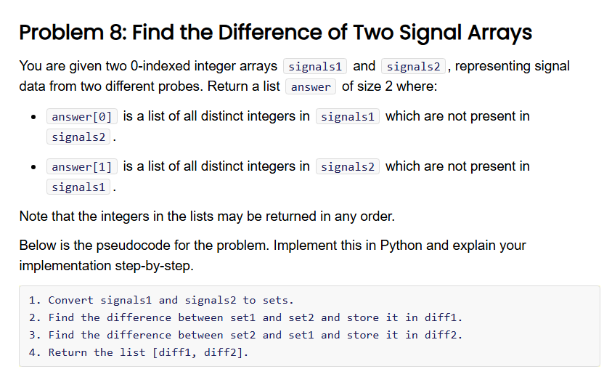

15 minutes
Unit 2 Session 1 Problem Sets
Notes:
🌟 Purpose: Demonstrate how to approach solving the "Find the Difference of Two Signal Arrays" problem by walking through the UPI (Understand, Plan, Implement) part of the UMPIRE strategy. Engage students in thinking critically, normalize mistakes, and emphasize a step-by-step problem-solving approach.
✅ What should I be doing?
Understand:
Read the problem statement aloud and clarify any ambiguities.
Identify inputs, outputs, and constraints with the class.
Plan:
Outline the pseudocode provided on the slide and explain the thought process behind each step.
Engage students in brainstorming alternative approaches or discussing the reasoning behind using sets for this problem.
Implement:
Write the code step by step in Python while explaining each part to students.
Debug errors (if any) live to model how to handle mistakes.
🎙️ What should I be saying?
Understand:
"Let’s read the problem together. We’re tasked with finding two lists: one containing elements in signals1 but not in signals2, and the other with elements in signals2 but not in signals1. What are our inputs and outputs?"
"Notice that the lists may be returned in any order, which simplifies our implementation a bit."
"How would you describe the constraints here? For example, how does the use of sets help us solve this efficiently?"
Plan:
"Here’s the plan: we’ll first convert the lists into sets. Why is this helpful? Because sets allow us to perform operations like finding the difference between two collections very efficiently."
"After that, we’ll find elements in signals1 not in signals2 and vice versa. Finally, we’ll return the results as a list of two sets."
"Can anyone think of another way to solve this problem? Why do you think sets are the most efficient option here?"
Implement:
"Let’s start coding this step by step. First, we’ll convert signals1 and signals2 into sets. Watch closely—this will make our operations faster."
"Next, we find the differences between the sets. I’m typing it out—please let me know if you spot anything I miss as I go. Mistakes are part of the process!"
"Lastly, we’ll combine the two results into a single list and return it. Let’s run this and check if it works. If there’s an error, we’ll debug together."
🙌🏽 How should I engage students?
Ask clarifying questions:
"What do you think the key difference is between using a list and a set for this problem?"
"How would you explain the difference operation in sets to someone else?"
Encourage participation:
"Can someone tell me what the output should look like if signals1 = [1, 2, 3] and signals2 = [3, 4, 5]?"
"If I accidentally try to subtract lists instead of sets, what error might we encounter?"
Normalize mistakes:
If an error occurs, say, "Ah, I made a typo here! Let’s see how we can debug this together. This is how real coding works—trial and error."
Debrief the solution:
After running the solution, ask, "Why do you think using sets is optimal here compared to other methods?"

Slide 36

Balancing AI with Independent Learning
Use AI as a supplement, not a replacement, for your own problem-solving!
Notes:
🌟 Purpose: Reinforce the importance of using AI tools as a support mechanism rather than a substitute for developing problem-solving and critical-thinking skills.
✅ What should I be doing?
Emphasize the role of AI as a learning tool and not a shortcut.
Encourage students to rely on their knowledge and reasoning while using AI to enhance their solutions.
Share practical examples of balancing AI assistance with independent work.
🎙️ What should I be saying?
Let’s talk about how we can integrate AI tools like ChatGPT into our learning process effectively. Remember, these tools are like the items in a toolbox. They’re incredibly helpful, but we still need to know how to use them properly and decide when to use them.
AI should supplement your problem-solving process, not replace it. For example, if you're working on a coding challenge and get stuck, you can ask AI for hints or explanations. But it's essential to try solving the problem on your own first.
The process of struggling through a problem is where the real learning happens. AI can clarify concepts, suggest approaches, or help debug, but don’t let it take over the thinking for you.
Over time, developing your independent learning skills will build your confidence and make you more resourceful in tackling challenges.
🙌🏽 How should I engage students?
Ask for examples:
"Can anyone share a time when they used AI to help with a problem? What did you do first before turning to the tool?"
Encourage reflection:
"How do you think over-relying on AI could impact your problem-solving skills? Let’s discuss this in the chat."
Normalize mistakes:
"It's okay if you’ve relied too much on AI in the past. The key takeaway here is to use it thoughtfully as you build your independent learning muscles."
Provide a scenario for discussion:
"Imagine you’re debugging a program that isn’t working. How would you approach the problem using both your skills and an AI tool?"

Slide 37

Break Time!
Take 5 mins to step away from the computer. Feel free to turn off your camera and return promptly after 5 mins.
Notes:
🌟 Purpose: Provide a short break to refresh and re-energize.
✅ What should I be doing?
Announce the break and remind students to return on time.
Play the countdown timer video (be sure to share sound).
🎙️ What should I be saying?
Let’s take 5 minutes to step away from the screen. Be sure to return promptly.

Slide 38
Collaborative Problem Solving
60 minutes

Slide 39
Choosing Your Breakout Room
We’ll share the room assignments.
We’ll demonstrate how to find your room assignment and navigate to your room.
Notes:
🌟 Purpose: Smoothly transition students into breakout rooms for collaboration.
✅ What should I be doing?
Share room assignments and explain how to join breakout rooms.
🎙️ What should I be saying?
Use the link to find your room and introduce yourself to your group.
🙌🏽 How should I engage students?
Check that everyone understands the process before sending them to breakout rooms.

Slide 40
50 minutes
🏃🏽 Navigate to your breakout room.
👋🏽 Introduce yourselves!
🧑🏽‍💻 Work on the problems for your selected unit.

Slide 41
Wrap Up
10 minutes

Slide 42
Traffic Lights
GREEN — Keep going! YELLOW — Proceed Slowly RED — Stop!

Slide 43
Notes:
🌟 Purpose: End the session on a positive note.
✅ What should I be doing?
Prompt students to share their reflections in the chat.
🎙️ What should I be saying?
Let’s celebrate your wins. Share one good thing you learned or accomplished today!
🙌🏽 How should I engage students?
Read a few responses aloud and celebrate with enthusiasm.

Slide 44


Session Survey Time!
TIP102 S1b
Week 2 Session 2
Notes:
🌟 Purpose: Gather feedback to improve future sessions.
✅ What should I be doing?
Share the survey link and emphasize its importance.
🎙️ What should I be saying?
Your feedback helps us make these sessions even better. Please take a moment to complete the survey.
🙌🏽 How should I engage students?
Thank students for their input and explain how feedback has been used in the past.

Slide 45

Final Reminders
Finish the problem sets for additional practice
Take the weekly HackerRank assessment by Sunday @ midnight
Notes:
🌟 Purpose: Reinforce key tasks and deadlines.
✅ What should I be doing?
Summarize next steps and encourage continued engagement.
🎙️ What should I be saying?
Don’t forget to complete the problem sets and take the HackerRank assessment by Sunday!
🙌🏽 How should I engage students?
Encourage students to ask any lingering questions before signing off.

